Slide 1



Why Not Watch?
Analysis Report of the
New Recommendation Engine
Impact on User Engagement
Presented by: Aliia Gismatullina s4051304
Notes:
Checking for the sound how is it going hello

Slide 2
Introduction
Social Metrics distribution in A/B groups
Linear Regression for Social Metric Variable
Challenges and Objectives
“Time since signup” distribution in A/B groups
Linear Regression for Time Since Signup Variable
Data Clarifications
Bias Assessment
Identified errors
Multiple Regression for Age, Gender and Social Metric Variables
Gender distribution in A/B groups
Possible solution: Stratification of the Age Variable
Discussion on the key insights
Age distribution in A/B groups
Stratification of the Gender Variable
Conclusion
Agenda

Slide 3

Why Not Watch?
Introduction
Why Not Watch? is committed to improving user engagement.
In pursuit of this, we recently introduced a new recommendation engine.
The current analysis serves to answer a crucial question:
Does the new recommendation engine significantly impact user engagement?
The insights gained from this evaluation will empower us to make a decision about the widespread implementation of the new recommendation algorithm.
BACK TO AGENDA

Slide 4
Challenges and Objectives
Why Not Watch?
Challenges
Objectives
Does the implementation of the new recommendation engine at WNW? significantly impact user engagement, as measured by the average hours watched per user per day?
How do demographic factors influence this impact?
Is there any bias present in data? If so, how can it be corrected?
What improvements can be proposed for future A/B tests?
A/B Testing.
Hypothesis Testing.
Regression Analysis.
Chi-squared Tests.
Stratification and Matching.
Visualizations.
BACK TO AGENDA

Slide 5
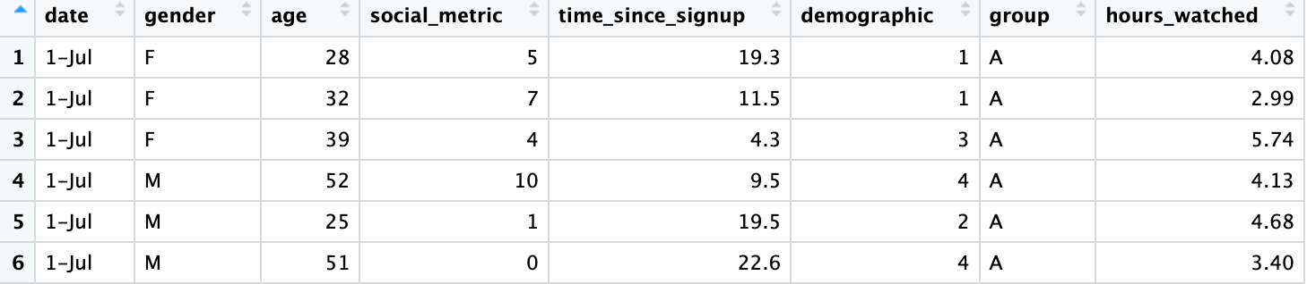
Data clarifications
Important variables | Factors and levels | Scale of numeric variables
Date Gender: Male and Female Age: ranges from 18 to 55 Social Metric: 0 to 10 Time Since Signup: 0 to 24 Demographic Number: 1 to 4 Group (A/B) Hours Watched: key metric for user engagement. | Gender variable has two levels: "M" for Male and "F" for Female. Group variable has two levels: "A" for the control group and "B" for the treated group. | Age: measured in years. Date: in dd-mm format. Social Metric: a combined metric based on previous viewing habits. Time Since Signup: number of months since signup.
BACK TO AGENDA

Slide 6
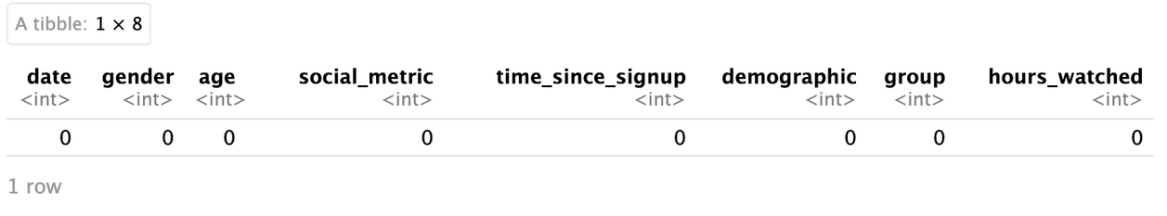
Bias Assessment
Is there any missing data?
Performing Demographic Distribution Analysis in A/B groups by:
Gender Age Social metrics "Time since Signup" Demographic Number
BACK TO AGENDA

Slide 7
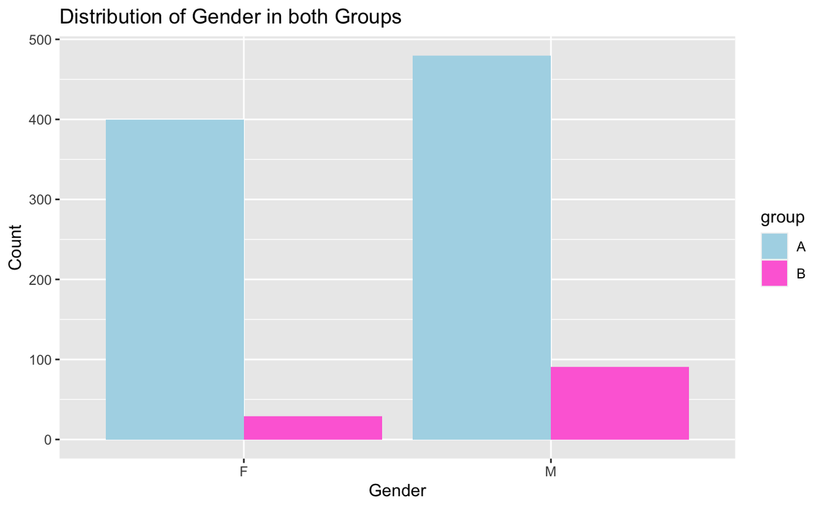
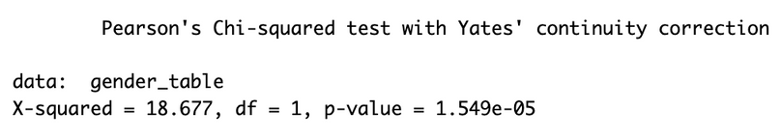
Gender distribution in A/B groups
Why Not Watch?
In Group B there is almost twice as more Males than Females, when in Group A the difference is not that strong;
To make a precise conclusion, I performed a Pearson's Chi-squared test.
p-value of 1.549e-05 (very close to 0) confirms the significant difference.
BACK TO AGENDA

Slide 8
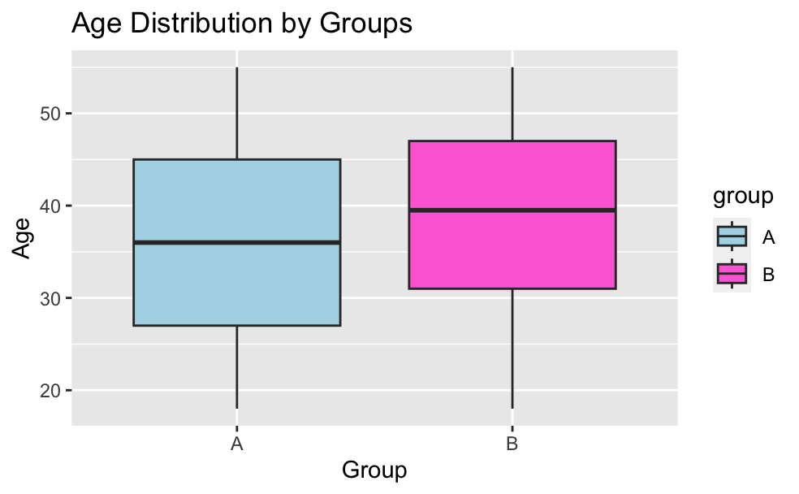
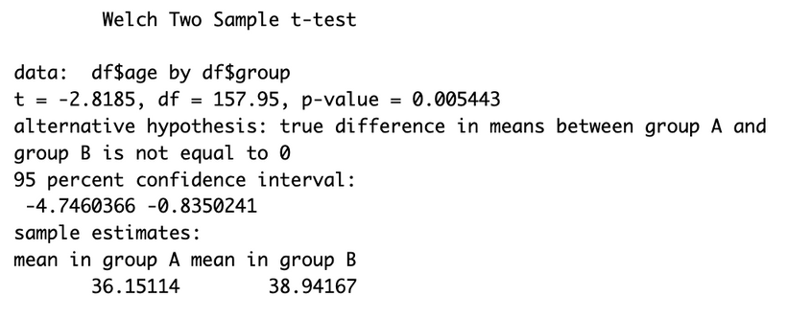
Age distribution in A/B groups
Why Not Watch?
The box plot presents some difference in age distribution in the groups: the average age in Group B appears to be higher.
To be precise, it makes sense to perform a t-test:
p-value of 0.005443, (less than 0.05), indicates significance;
the mean age for Group B (38.94) is higher than for Group A (36.15);
the 95% confidence interval is between -4.75 and -0.84, confirming the difference.
BACK TO AGENDA

Slide 9
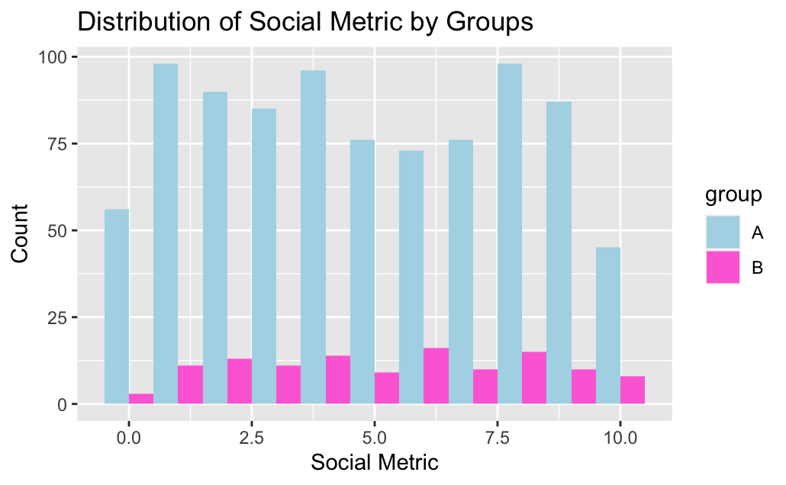
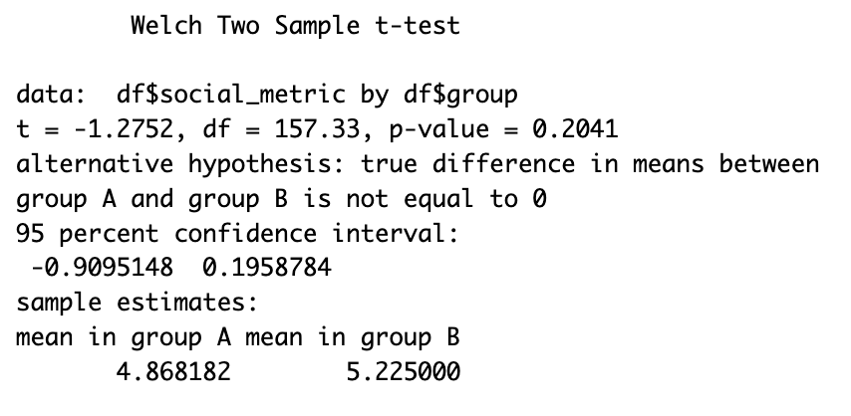
Social Metrics distribution in A/B groups
Why Not Watch?
Social metrics are seem to be distributed equally in both groups;
t-test was performed to make it clear.
p-value of 0.2041 (>0.05). This indicates that there is no statistically significant difference.
95% confidence interval ranges from -0.91 to 0.20, supporting the absence of a significant difference.
BACK TO AGENDA

Slide 10
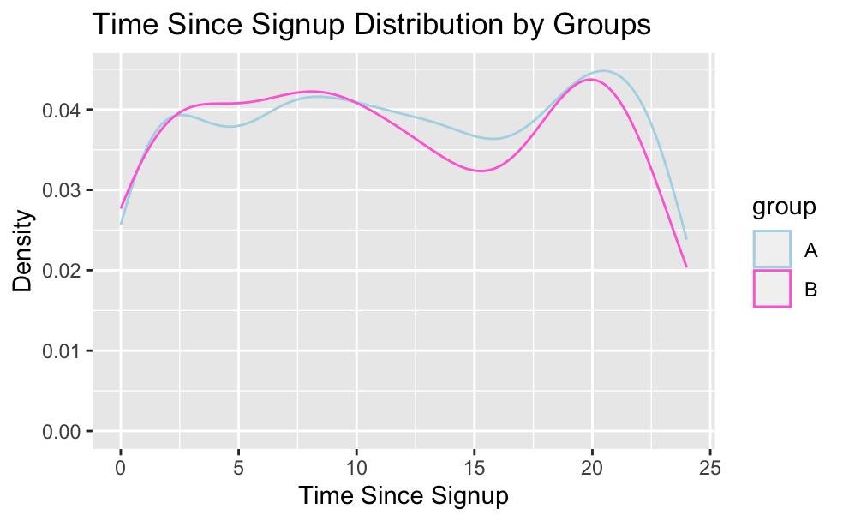
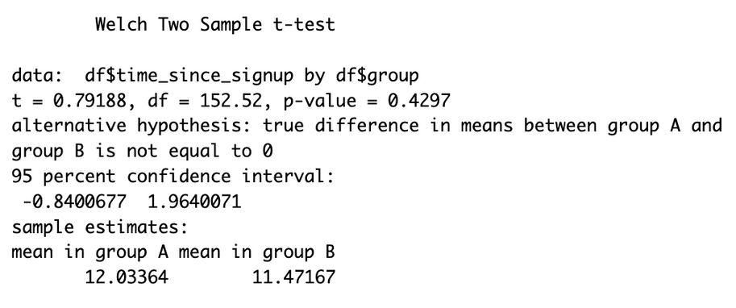
"Time since Signup" distribution in A/B groups
Why Not Watch?
In the current plot we can note a slight, but not significant difference. Here is the t-test to confirm it:
p-value is 0.4297 (greater than 0.05);
the 95% confidence interval ranges from -0.84 to 1.96, confirming the absence of a major difference.
BACK TO AGENDA

Slide 11
Identified errors
Why Not Watch?
01
02
03
Possible errors in sampling are found in:
How do these errors implicate the analysis and interpretation of the A/B test results?
Statistical techniques to address errors:
Age,
Gender variables.
Stratification
Matching
Linear and multiple regression
They have the potential to introduce bias and impact the validity of the A/B test results.
BACK TO AGENDA

Slide 12
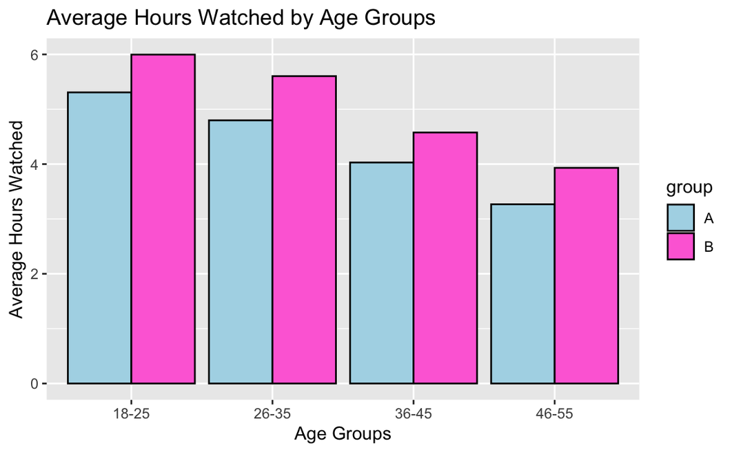
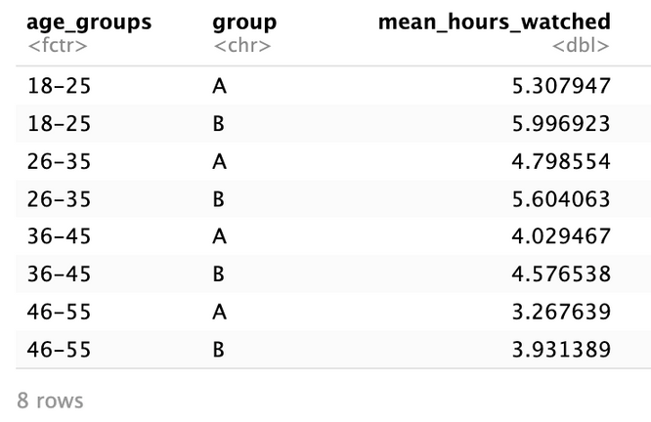
Possible solution: Stratification of the Age Variable
Why Not Watch?
Average hours watched per user per day for each age group, considering A/B groups
01
The data suggests that, within each age group, group B tends to have a higher average hours watched compared to group A.
This confirms that the recommendation engine change may have worked towards increased user engagement in all the age groups.
BACK TO AGENDA

Slide 13
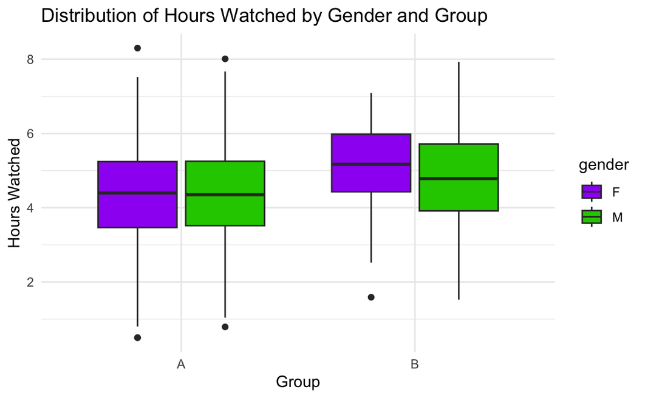
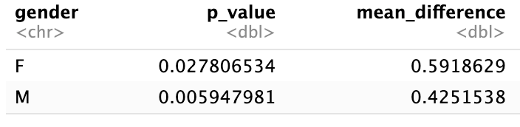
Stratification of the Gender Variable
Why Not Watch?
Mean hours watched difference between groups A and B and t-test results
01
Reviewing the results:
The new recommendation engine produces more promising results for the female users, as evidenced by the distribution of hours watched.
This demonstrates the potential effectiveness of the updated engine in raising user engagement among female audience.
BACK TO AGENDA

Slide 14
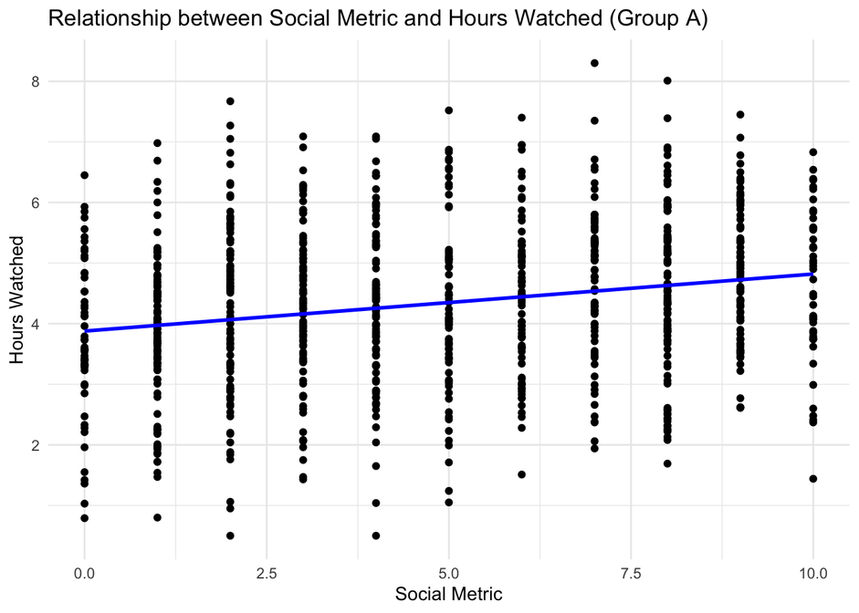
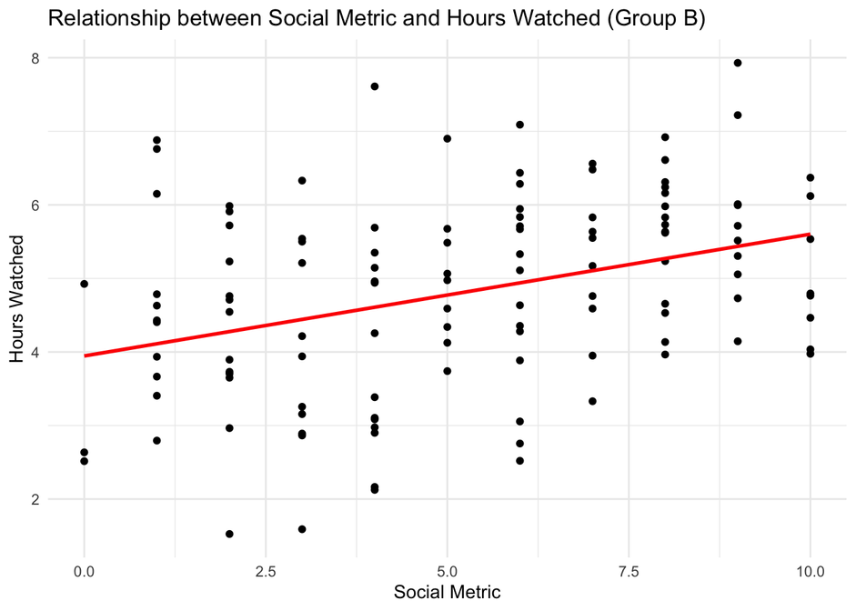
Investigation of Key Metrics
Linear Regression for Social Metric Variable
Why Not Watch?
Insights on the results of the regression analysis and the visualization:
the new recommendation engine (group B) had a reasonable effect on the “hours watched” metric considering the “social metric” variable.
In comparison to group A, group B has a more pronounced regression line in the visualization. This implies that the modifications made to the new recommendation engine may have boosted user participation in Social Metrics.
BACK TO AGENDA

Slide 15
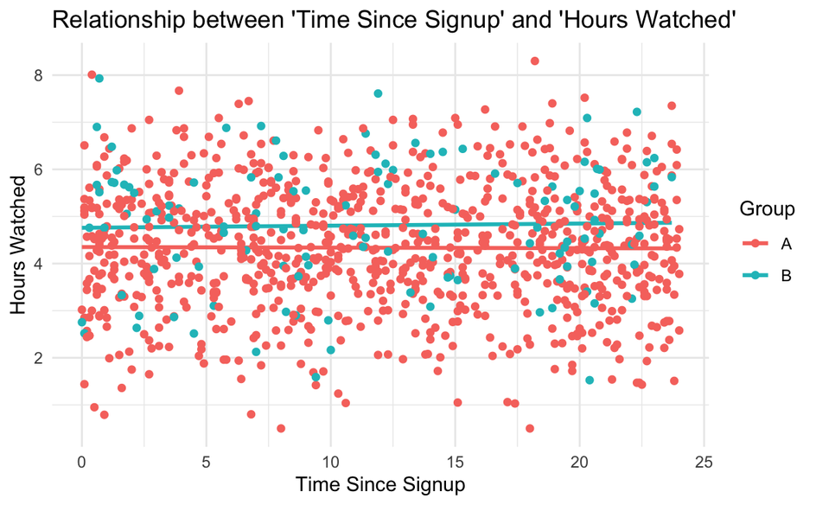
Investigation of Key Metrics
Linear Regression for Time Since Signup Variable
Why Not Watch?
Insights on the results of the regression analysis and the visualization:
Group A:
- p-value is 0.845, indicating that the relationship between "Time since signup" and "Hours watched" is not significant.
- multiple R-squared value is 0.000044.
Group B:
- p-value for the "time since signup" is 0.789, indicating no significant relationship between "Time since signup" and "Hours watched."
- multiple R-squared value is 0.000607.
According to these results, the duration of a user's subscription ("time since signup") does not seem to be a strong indicator of the amount of content consumed ("hours watched") for either group.
BACK TO AGENDA

Slide 16
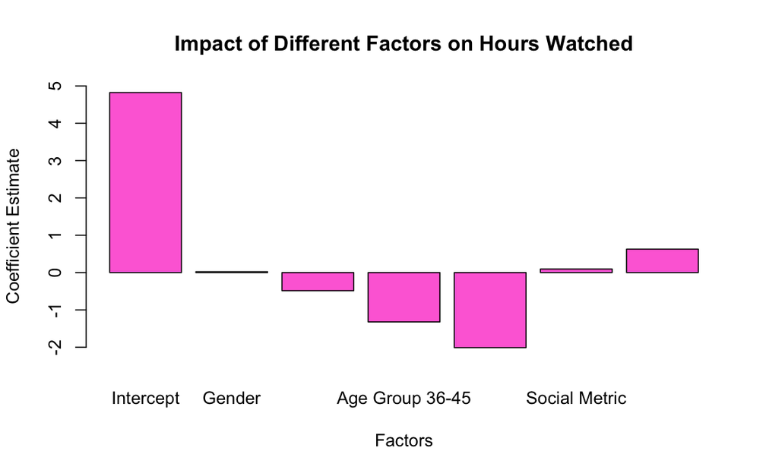
Investigation of Key Metrics
Multiple Regression for Age, Gender and Social Metric Variables
Why Not Watch?
The model provides the following insights as a result of the outcomes of the multiple regression analysis:
Gender: does not appear to have a crucial impact on the hours watched indicator.
Age: when compared to the reference group (18-25), the age groups of 26-35, 36-45, and 46-55 show significant negative relationships with the hours watched metric.
Social Metric: is also significant (p-value < 0.05), indicating that, as the social metric grows, the hours watched metric also grows.
Group Effect: the coefficient for the Group B variable is roughly 0.63, showing that the new recommendation engine (group B) caused a rise in viewing time compared to the control group A.
BACK TO AGENDA

Slide 17
Discussion on the key insights
Strengths and Limitations of the A/B test
Why Not Watch?
Strengths
Limitations
Future Directions
Thorough examination of numerous demographic aspects (age, gender, social metric, time since signup);
A clear demonstration of how the new recommendation engine affects user engagement;
Might not have captured long-term patterns;
External variables or user preferences that can impact participation;
Some complicating variables might not have been taken into account.
Long-term analysis;
Qualitative Research;
Feature Analysis.
BACK TO AGENDA

Slide 18
- User Engagement: Average hours watched increased after the implementation of the new recommendation engine.
- Key Factors:
a. Age and Social Metrics were key demographic determinants;
b. Gender had minimal influence.
- Continuous Monitoring
- Data-Driven Strategy
Why Not Watch?
Conclusion
BACK TO AGENDA

